Slide 1
Linked Building Data community efforts
4th Int’l Workshop on Linked Data in Architecture and Construction (LDAC)
Madrid, Spain
Pieter Pauwels, Ghent University
21 June 2016

Slide 2
1. The community track
2. LDWG status
3. Standardisation
4. Industrial uptake
Outline

Slide 3
LDAC 2015
LDAC 2014
LDAC 2012

Slide 7
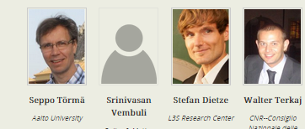
Joining / combining initiatives
MVD
linkedbuildingdata.net
ifcOWL
bSDD
www.w3.org/community/lbd/
LDAC event
W3C LBD Community Group
BuildingSMART Linked Data Working Group
linkedbuildingdata people

Slide 8
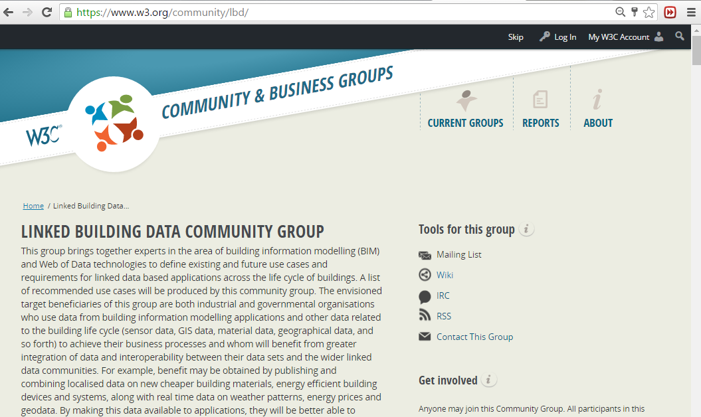

Slide 9
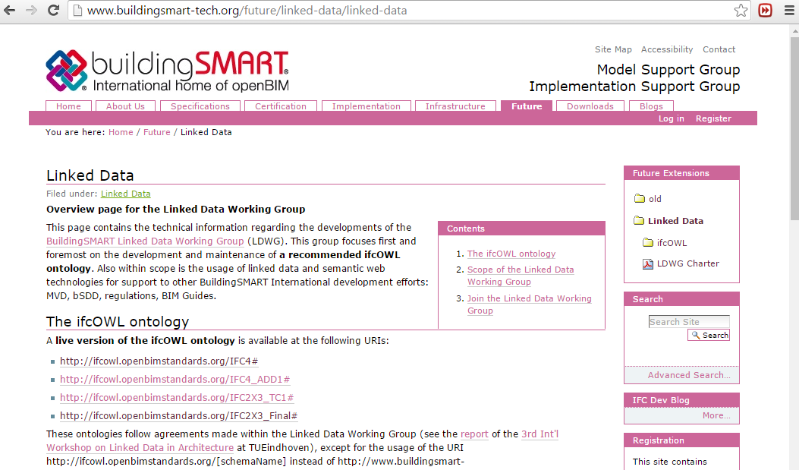

Slide 11
1. The community track
2. LDWG status
3. Standardisation
4. Industrial uptake
Outline

Slide 12
Joining / combining initiatives
MVD
linkedbuildingdata.net
ifcOWL
bSDD
www.w3.org/community/lbd/
LDAC event
W3C LBD Community Group
BuildingSMART Linked Data Working Group
linkedbuildingdata people

Slide 13
Toronto ITM October 2014
Watford ITM March
2015
Singapore ITM October 2015
Rotterdam ISM April 2016
CIB W78 2015
Eindhoven
SWIMing VoCamp 2016
Dublin
LDAC 2014
Helsinki
LDAC 2015
Eindhoven
LDAC 2016
Madrid

Slide 14
BuildingSMART
Infrastructure Room
Technical Room
Building Room
Product Room
Regulatory Room
BIM
Infra GIS
ifcOWL
IDMs
MVDs
BIM-Guides
bSDD
Rules

Slide 15
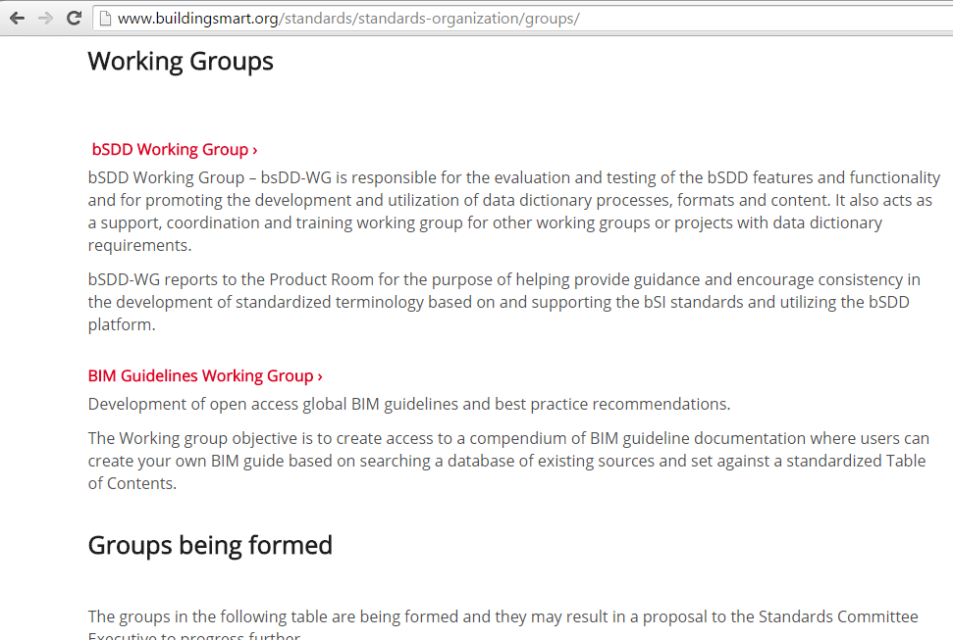
Officialisation of Linked Data Working Group
Linked Data Working Group >
The Linked Data Working Group is responsible for building and maintaining a recommended version of an ifcOWL ontology as an equivalent to the IFC EXPRESS schema. The ifcOWL ontology is to be used in linked data and semantic web applications that consume IFC data.

Slide 16
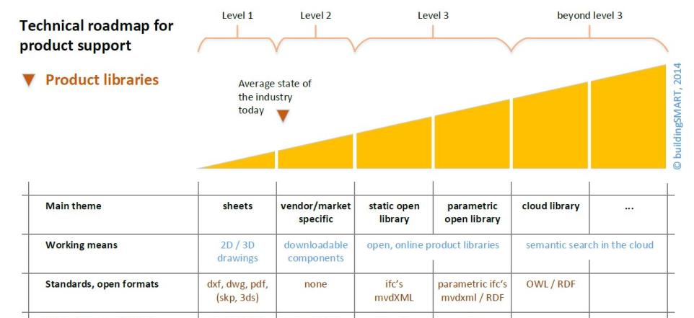
Fit in BuildingSMART activities
Purpose:
Bring together experts in BIM and Web of Data technologies to define existing and future use cases and requirements for linked data based applications across the building life cycle.
http://www.buildingsmart.org/standards/technical-vision/technical-roadmaps/

Slide 17
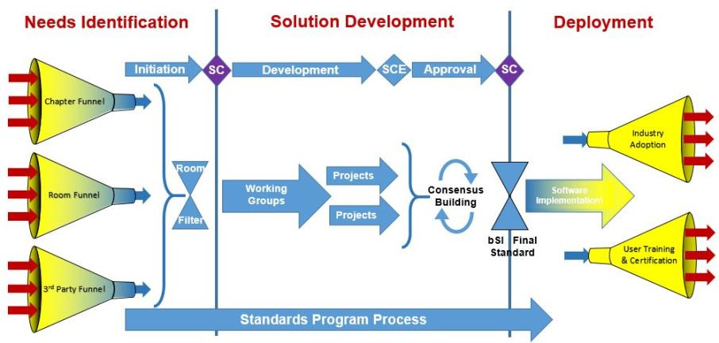
Status in the standards process
http://www.buildingsmart.org/standards/standards-process/

Slide 19
1. The community track
2. LDWG status
3. Standardisation
4. Industrial uptake
Outline

Slide 21
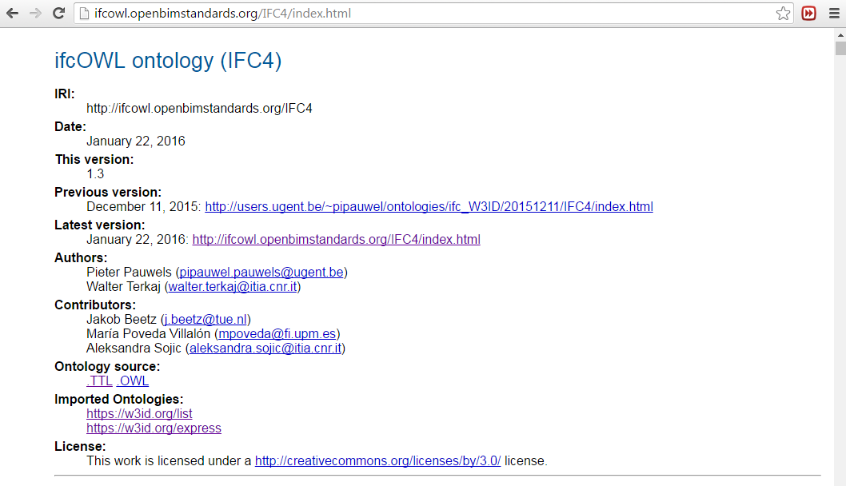

Slide 22
IFC-SPF
EXPRESS
XML
XSD
RDF
ifcOWL

Slide 23
BuildingSMART
Infrastructure Room
Technical Room
Building Room
Product Room
Regulatory Room
BIM
Infra GIS
ifcOWL
IDMs
MVDs
BIM-Guides
bSDD
Rules

Slide 25
IfcDoc support

Slide 26
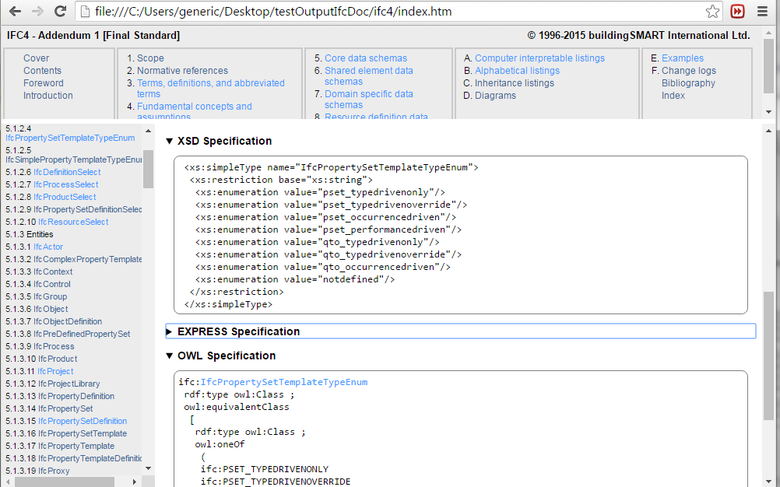
Implementation in IfcDoc

Slide 27
1. The community track
2. LDWG status
3. Standardisation
4. Industrial uptake
Outline

Slide 28
BuildingSMART
Infrastructure Room
Technical Room
Building Room
Product Room
Regulatory Room
BIM
Infra GIS
ifcOWL
MVDs
IDMs
MVDs
BIM-Guides
bSDD
Rules

Slide 29
- Agile data handling
- SPARQL query access
- Subset selection
MVD
- Custom data
- Systems Engineering (SE)
- Graph DBs
BIM-Infra-GIS
- Product data templates
- Manufacturer data
bSDD
- Regulation compliance checking
Rules

Slide 32
Thank you
Pieter Pauwels, Ghent University
pipauwel.pauwels@ugent.be

Slide 33
Bonus material

Slide 34
ifcOWL
Converter?
Rules?
…?
IFC-SPF
RDF
RDF
EXPRESS
ifcOWL
simpleBIM
Converter?
Rules?
…?
Go to exit

Slide 35
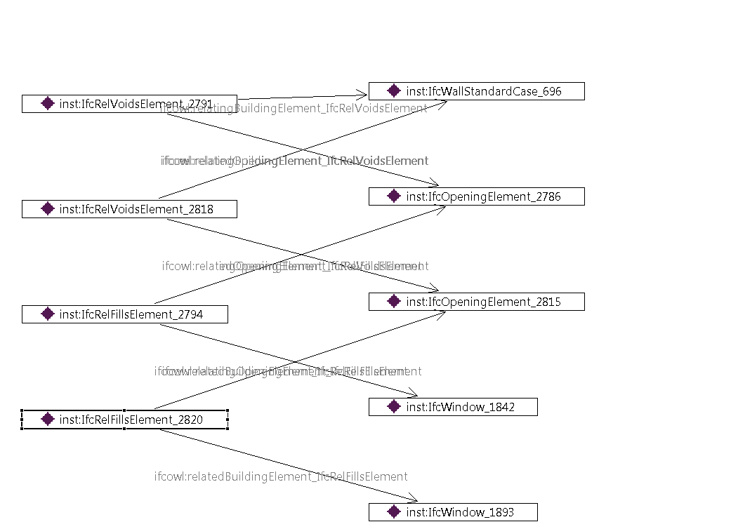
ifcOWL
inst:IfcWallStandardCase_696
simplebim:hasWindow
simplebim:hasWindow
inst:IfcWindow_1893
inst:IfcWindow_1842

Slide 37
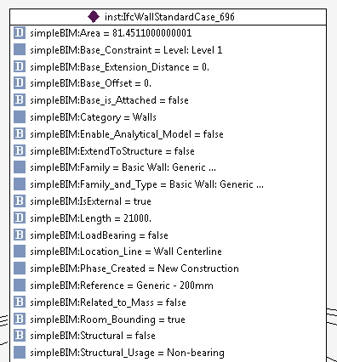

Slide 38
Model ifcOWL ifcOWL simpleBIM simpleBIM
1 767kb 10,173 triples 1,339 triples 83kb
2 16,7 MB 225,135 triples 16,836 triples 1.029kb
REDUCTION TO
8,5% file size
10,3% triple count

Slide 39
ifcOWL
Converter?
Rules?
…?
IFC-SPF
RDF
RDF
EXPRESS
ifcOWL
simpleBIM
Converter?
Rules?
…?

